Slide 1
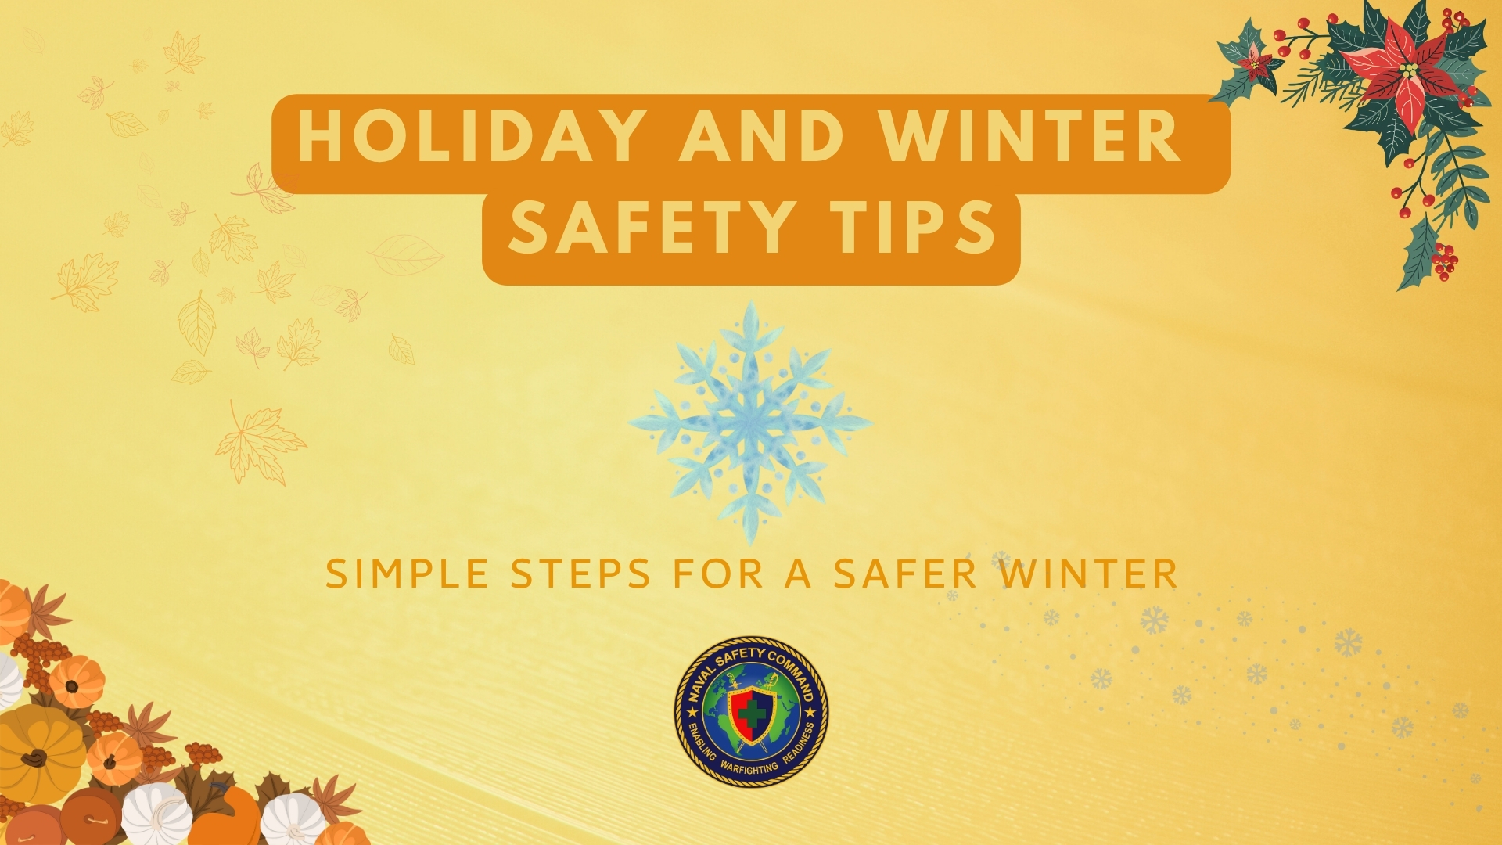

Slide 2
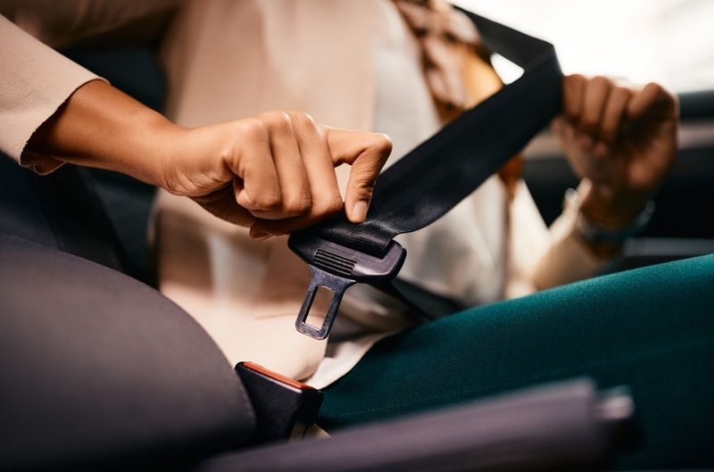
Thanksgiving travel
Thanksgiving is one of the deadliest times on the road.
Between 2019 and 2023, 868 people were killed in drunk driving crashes over the Thanksgiving holiday.
The National Safety Council predicts an estimated 502 fatalities will occur on the road over this coming Thanksgiving holiday period.
Always wear your seatbelt no matter the driving distance.
Never drive impaired, drive sober.

Slide 3
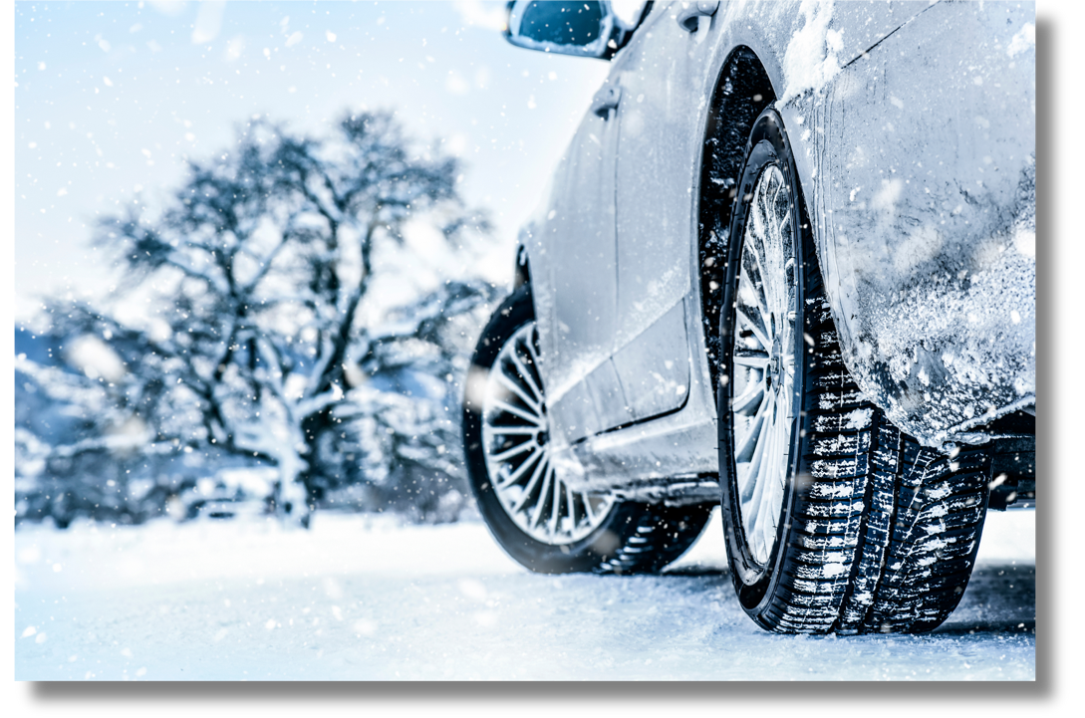
Holiday Travel TIPS
Ensure vehicle maintenance is up to date
Check the weather forecast and dress accordingly
Keep extra blankets, a flashlight and water in your vehicle in case of severe wintry weather

Slide 4
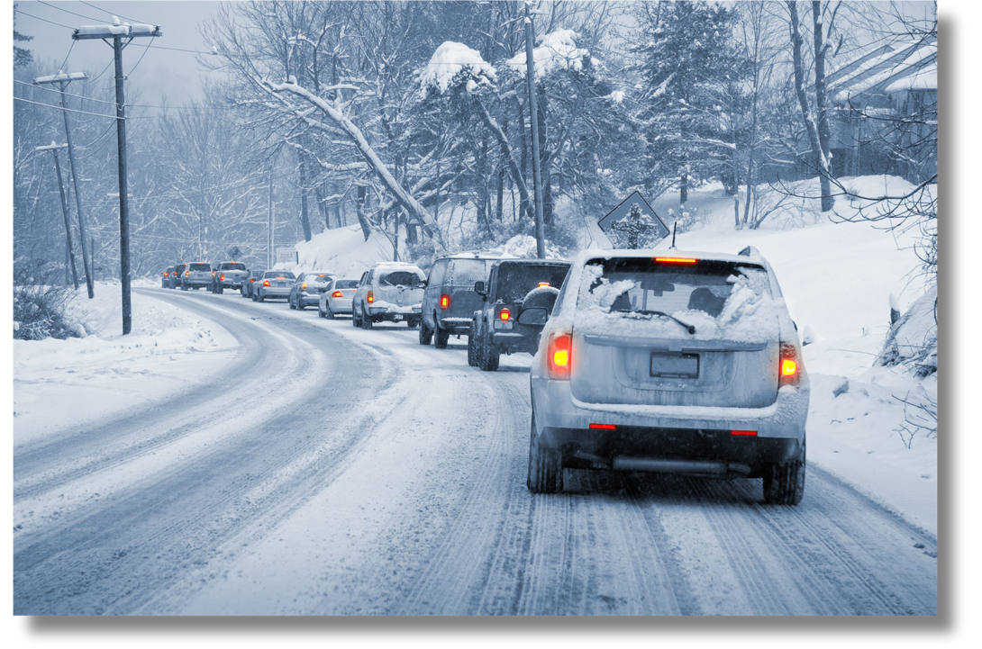
Safe driving tips
Know your car’s capabilities and educate yourself on the safety features of your vehicle
If using all-season tires, check tread and replace if worn down to less than 2/32 of an inch
Avoid driving while tired. Fatigue can be as dangerous as alcohol behind the wheel

Slide 5

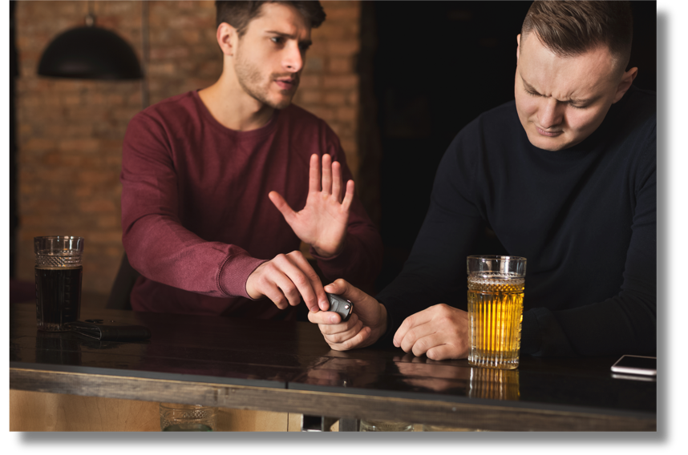
Drinking and driving
Don’t let a DUI put a halt to your festivities
Plan ahead so you don’t have to drive
Use a rideshare service if unable to drive
Pick a non-drinking friend to be the designated driver

Slide 6
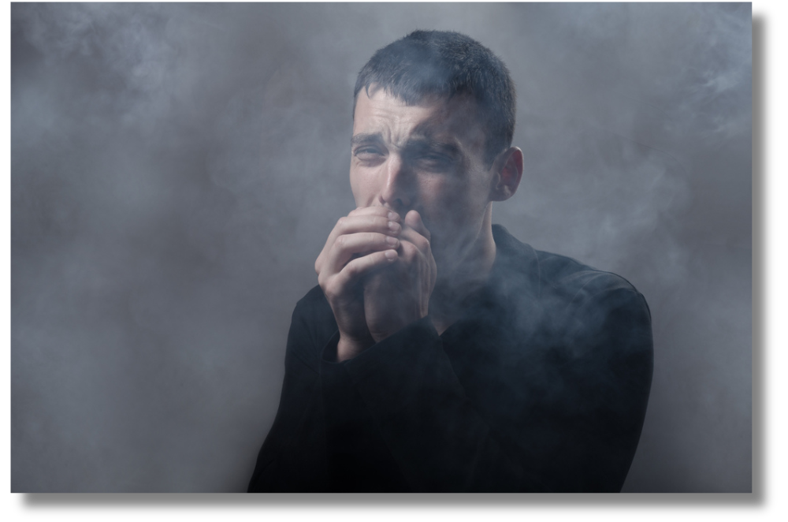
Carbon monoxide awareness
Install a working carbon monoxide detector in the hallway near each sleeping area inside your home
Use portable generators outdoors in well-ventilated areas away from all doors, windows and vents
Make sure vents for the dryer, furnace, stove and fireplace are clear of snow and other debris
Notes:
Carbon monoxide (CO), often referred to as the “invisible killer,” is a poisonous gas that has no color or odor. Because it cannot be detected by human senses, individuals may be unaware when they are being exposed to it. Anyone can be at risk, including infants and the elderly. Here are some tips to stay safe:

Slide 7
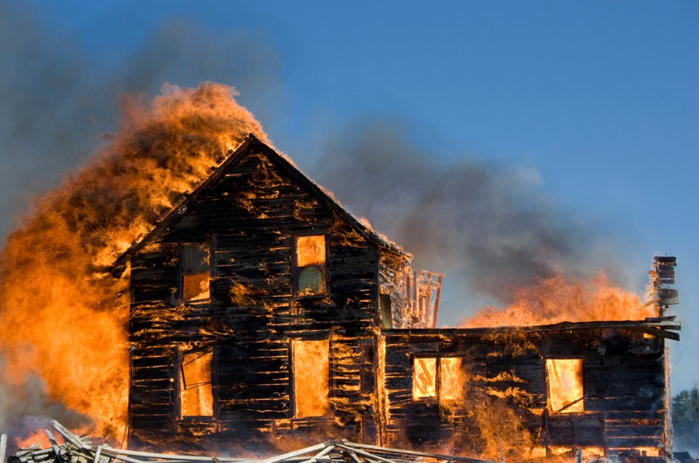
Home fires
There were 344,600 home fires and 2,890 deaths reported in the U.S. in 2023.
Electrical distribution or lighting equipment was involved in more than 43% of home Christmas tree fires
Thanksgiving is the peak day for home cooking fires, followed by Christmas Day and Christmas Eve.
In 2021, U.S. fire departments responded to roughly 170,000 home cooking fires. These incidents resulted in roughly 135 deaths, 3,000 injuries, and more than $494 million in property damage.
Notes:
Holiday celebrations, twinkling lights, and winter greenery are hallmarks of the season that can quickly become fire hazards.
In 2023, there were 344,600 home fires and 2,890 deaths reported across the United States, highlighting the continued need for fire prevention and safety awareness.

Slide 8
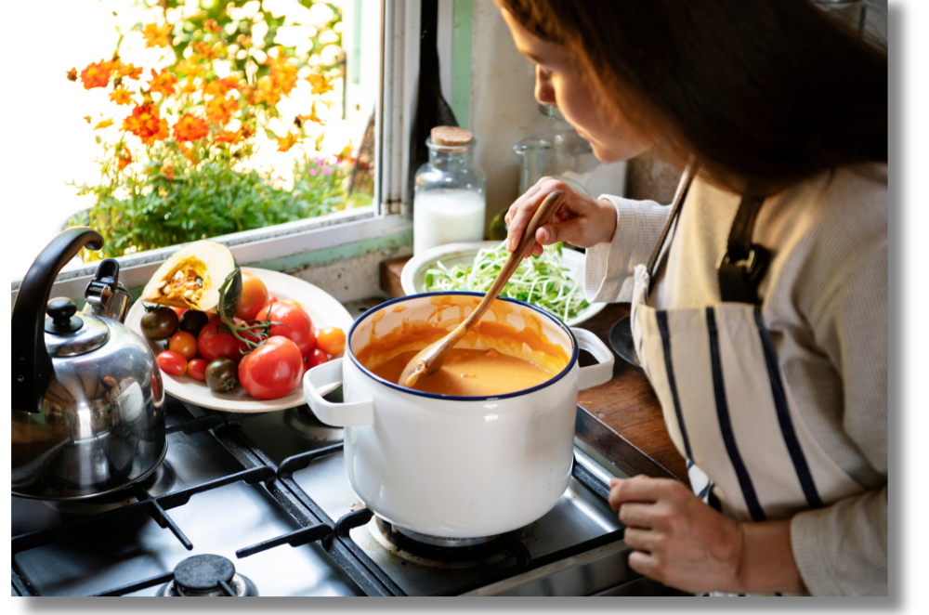
Home cooking fire tips
The primary cause of ignition in nonconfined home cooking fires was unattended cooking equipment, accounting for 37% of cases.
Remember these tips when cooking:
Stay in the kitchen when using cooking oil
Never cook when you are tired
Stand by your pan. If you leave the kitchen, turn the burner off

Slide 9

Safe Decorating tips
Turn off all lights and decorations before going to bed or leaving the house
Use indoor and outdoor lights in their appropriate locations
Place your tree at least three feet away from any heat source
Choose decorations that are flame resistant or flame retardant
Water your Christmas tree daily. Dry trees ignite and burn quickly
Use battery-operated flameless candles as an alternative to real ones

Slide 10


Home heating tips
Keep anything flammable at least three feet from heat sources
Turn space heaters off when leaving the room
Maintain heating equipment and chimneys by having them cleaned and inspected

Slide 11

Resources
For seasonal guidance and more information on Fall, Holiday and Winter safety topics, visit https://navalsafetycommand.navy.mil/Off-Duty/Fall-and-Winter-Safety.
Remember, what you do both on and off duty can have a lasting impact on your family, friends and your team. Staying safe keeps you combat-ready and able to do what’s needed to carry out the mission.

